Slide 1
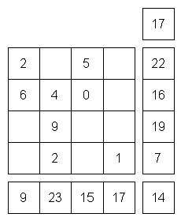

Slide 3
Intro to AzureML
Heather Shapiro
Technical Evangelist
@microheather

Slide 4
When to use data science?
Predicting outcome of a lottery?
Machine Learning does not work well on predicting something that is inherently random.
No Pattern No ML

Slide 5
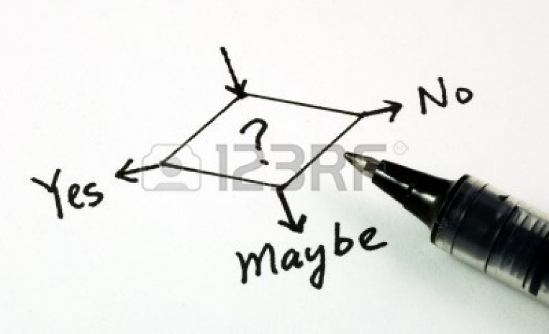
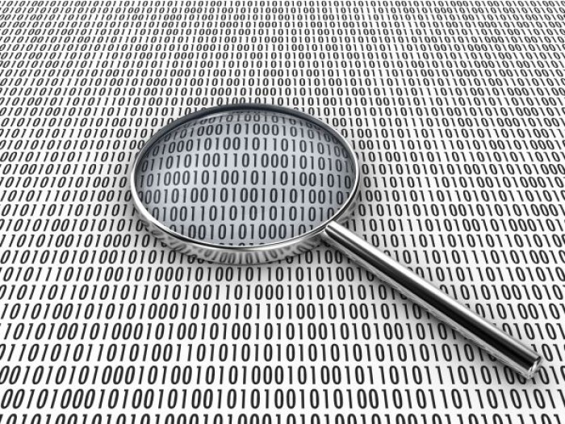
Problem Requirements
Valuable business problem involving decision
Existing process
Metrics
Available data
Related to the decision
Historical
Outcomes
Notes:
http://us.123rf.com/400wm/400/400/johnkwan/johnkwan1008/johnkwan100800099/7596302-yes-no-or-maybe-concepts-of-making-business-decision.jpg

Slide 6

Data tells us a story

Slide 7

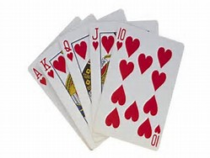
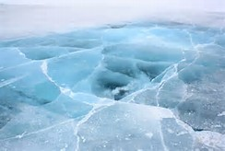

Probability
The Number Of Ways Event A Can Occur
The total number Of Possible Outcomes
P(A) =
Notes:
Pizza example

Slide 8
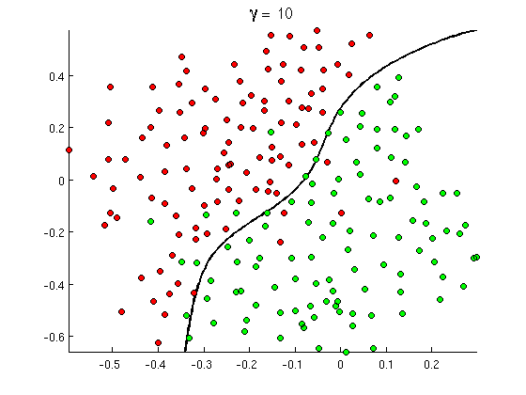
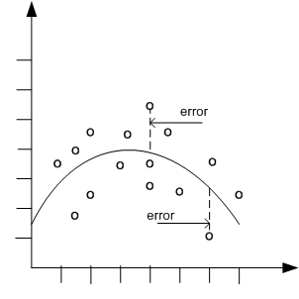

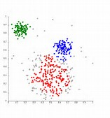
Common Classes of Problems
Classification
Regression
Recommenders
Clustering
Notes:
http://openclassroom.stanford.edu/MainFolder/courses/MachineLearning/exercises/ex8materials/ex8b_10.png
http://docs.oracle.com/cd/B28359_01/datamine.111/b28129/img/scatter_plot_nonlinear.gif
http://spectrum.ieee.org/img/RecommendNEWf1-1348253703748.jpg
Hogwarts

Slide 9
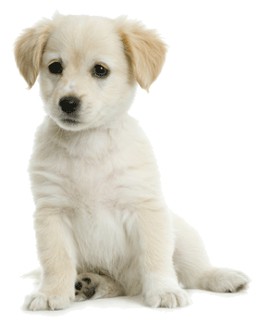

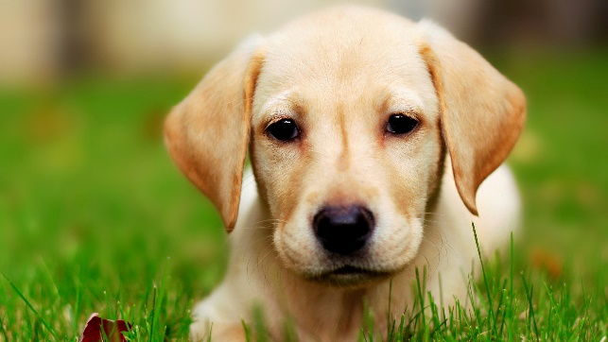
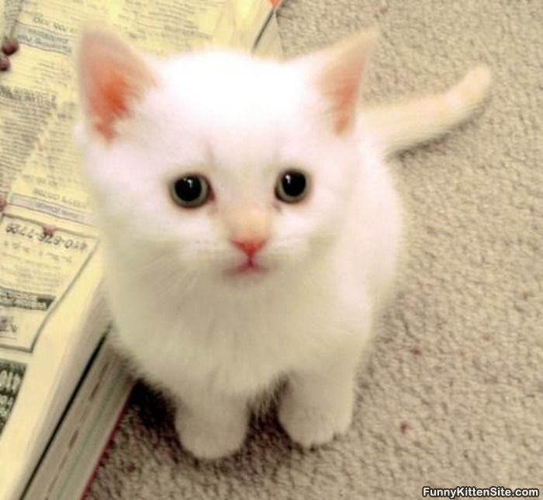
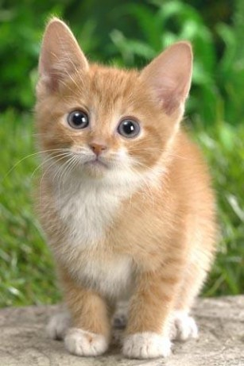
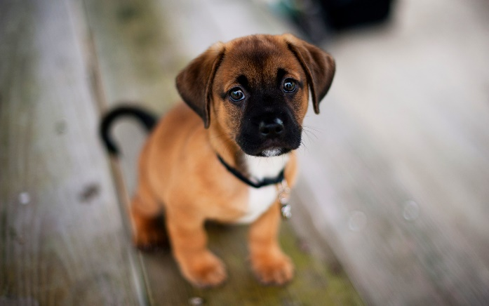
Classification
Think categories
Example: Cat or Dog?

Slide 10
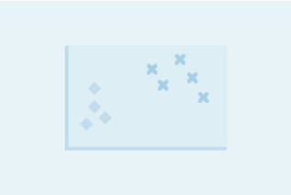
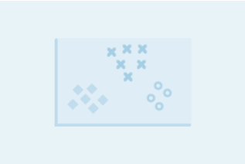
Binary vs. Multiclass Classification
Binary examples
Is that email spam or not spam?
Is that person on Twitter a psycho?
Multiclass examples
What kind of flower is that?
Which Hogwarts house do I belong in?

Slide 11
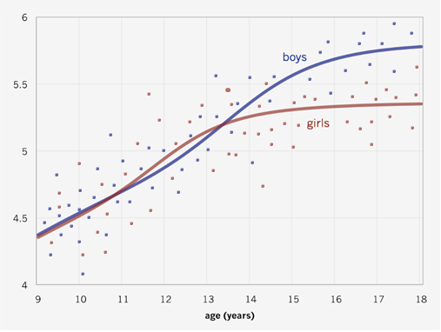
Regression
Predicting a numerical value
Example: How old are you based on your height?
height (ft)

Slide 12
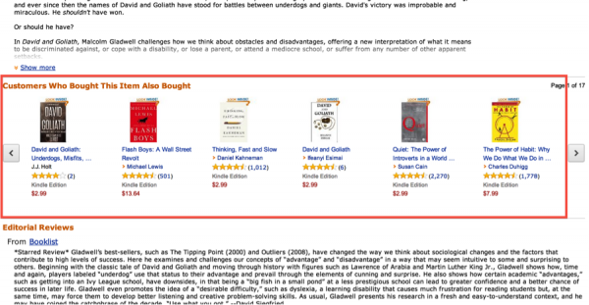
Recommenders
Suggestions based on things you like

Slide 13
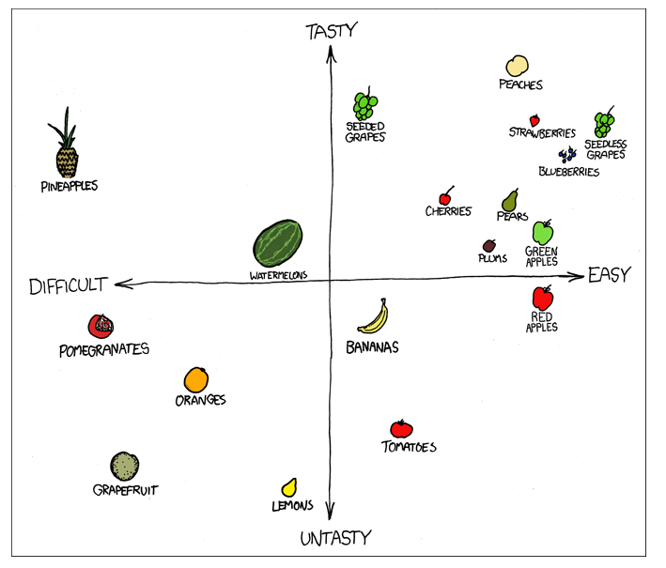
Clustering
Grouping similar things

Slide 14
What makes for a good ML problem?
Labeled examples
Spam detection: examples of spam email and regular email
Twitter crazies: examples of psychos on twitter vs. other people
Relevant features
Email information: subject line, sender email address, words in email
Twitter user information: age, gender, how often he/she tweets, words and phrases used in tweets
Uncertainty/error tolerance
Finding some junk mail is better than missing important email
Automated psycho identification still verified by human

Slide 15
Studio.azureml.net

Slide 16
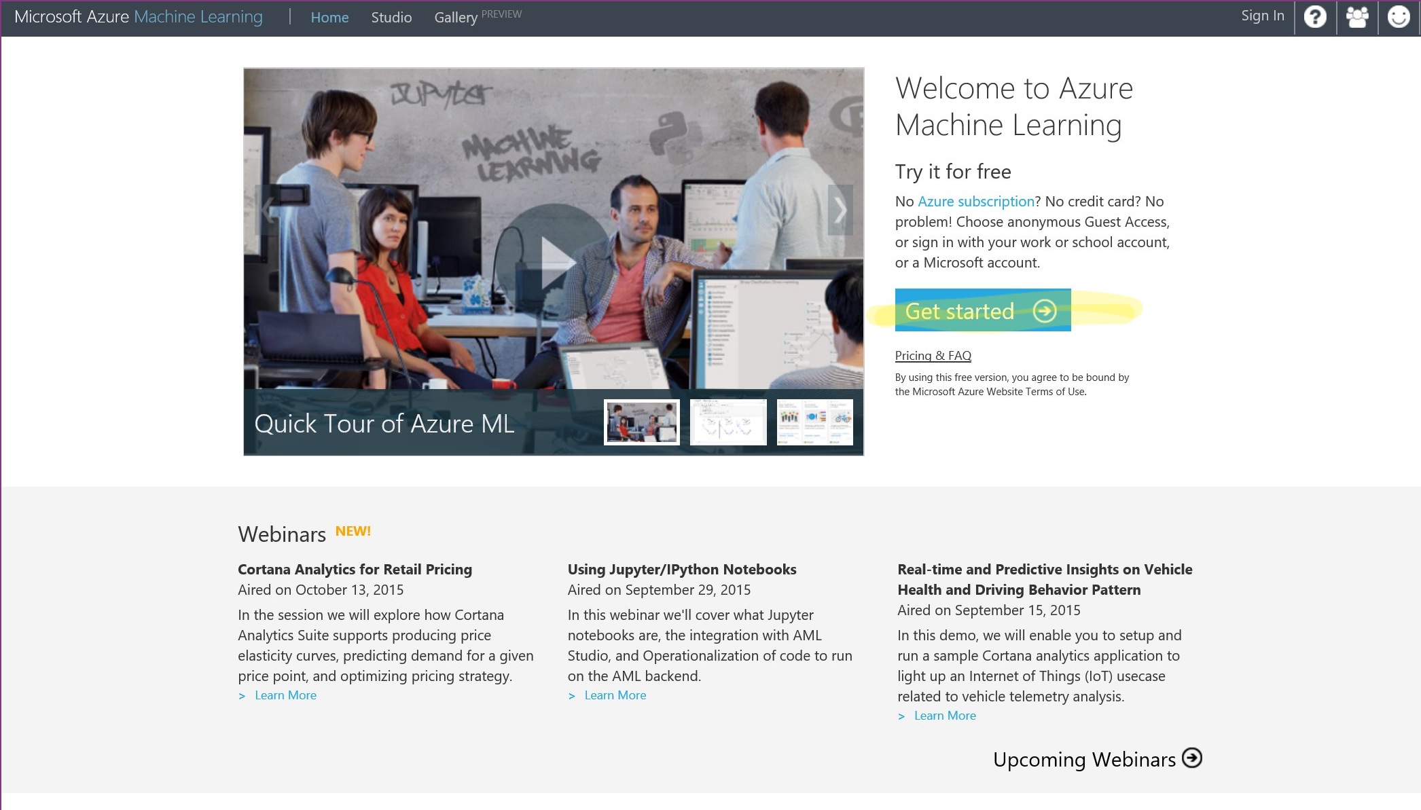

Slide 17
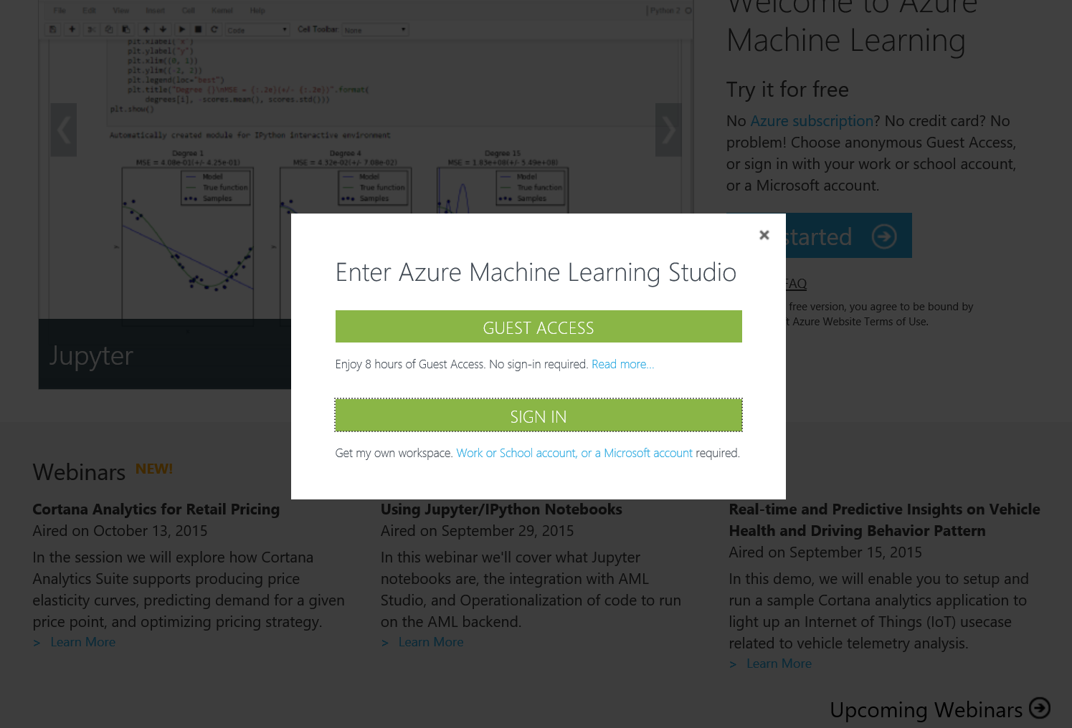

Slide 18
Sign in with the emails we created

Slide 19
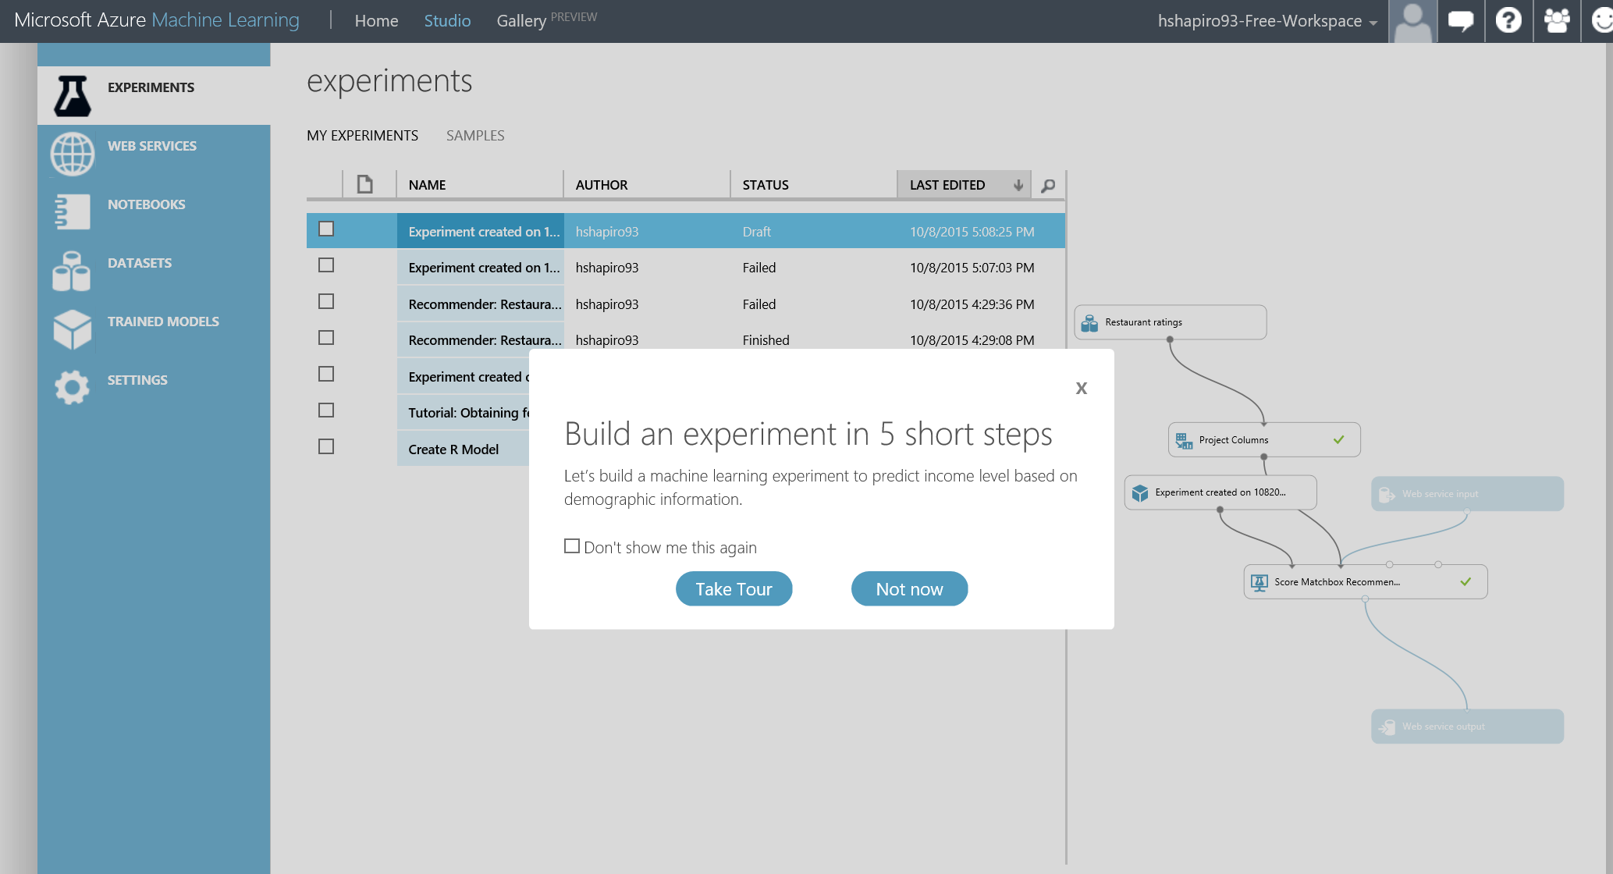

Slide 20
How do we visualize the results???

Slide 21
app.raw.densitydesign.org

